Slide 1
Decision Trees

Slide 2
What is Decision Trees?
A decision tree is a flowchart-like structure in which each internal node represents a "test" on an attribute (e.g. whether a coin flip comes up heads or tails), each branch represents the outcome of the test, and each leaf node represents a class label (decision taken after computing all attributes).

Slide 3
Sample real world examples
Should I attend this lecture?
Should I watch this movie?
Will I graduate?
Will it rain today?
How do I unblock my credit card?

Slide 4
How do you construct a decision tree?
• Strategy: top down Recursive divide-and-conquer fashion • First: select attribute for root node Create branch for each possible attribute value • Then: split instances into subsets One for each branch extending from the node • Finally: repeat recursively for each branch, using only instances that reach the branch • Stop if all instances have the same class

Slide 5

How do you construct a decision tree?
Branch
Root Node – Represents the base and the entire population originates from here
Parent Node – The node preceding the node
Child Node – The node succeeding the current node is
Splitting – Dividing the node into different parts
Leaf node – The bottom most node, which can not be further segregated
Branch – Formed by splitting the tree/node
Leaf
Parent
Child
Root

Slide 6
Sample data set
Describe this data set ?

Slide 7
Sample data set
Outlook
Root Node
sunny
overcast
rain
Parent Node
overcast
humidity
windy
Child Node
high
normal
true
false
Leaf Node

Slide 8
Alright, how do we split?
At each node, available attributes are evaluated on the basis of separating the classes of the training examples. A Goodness function is used for this purpose
Typical goodness functions:
information gain (ID3/C4.5)
information gain ratio
gini index

Slide 9
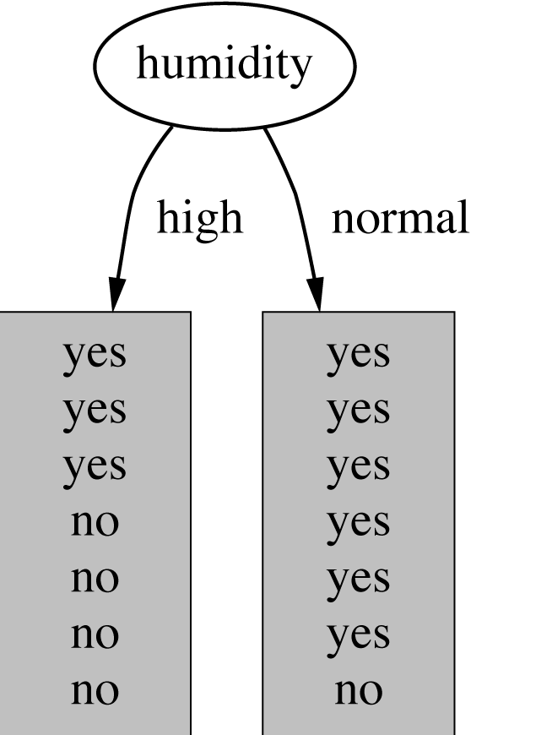
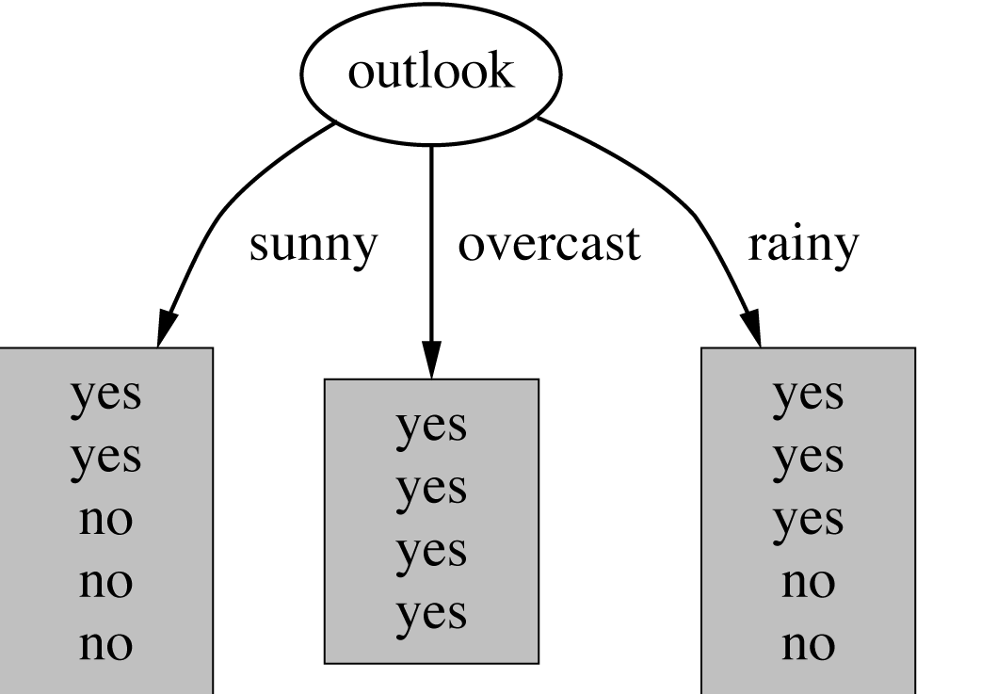
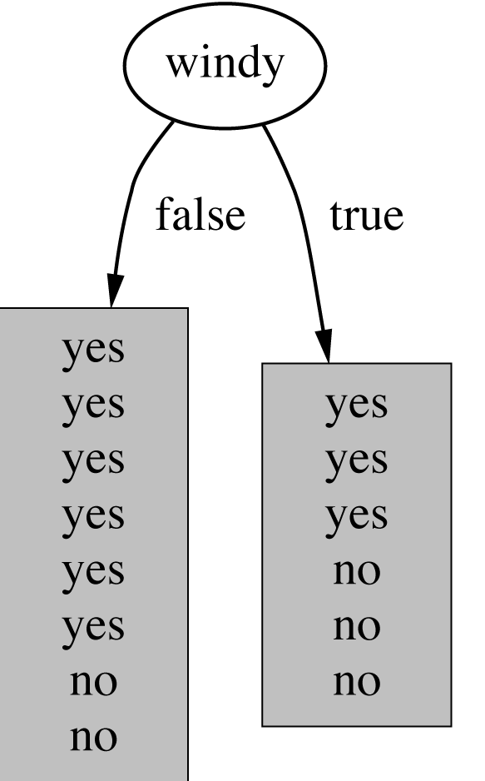
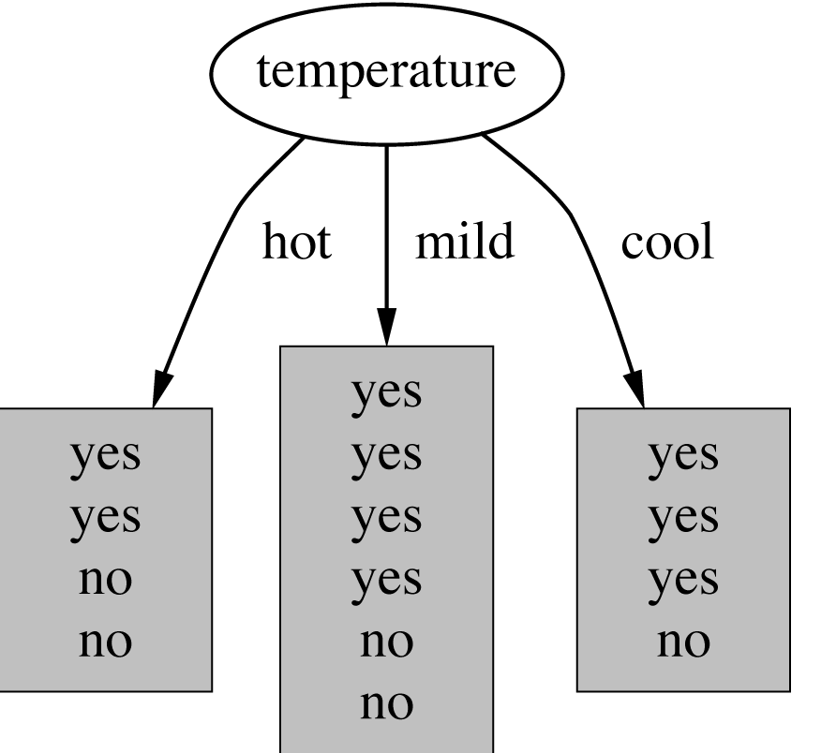
Sample splits

Slide 10
Lets talk about information gain
Information is measured in bits
Given a probability distribution, the info required to predict an event is the distribution’s entropy
Entropy gives the information required in bits (this can involve fractions of bits!)
Formula for computing the entropy:

Slide 11
Information from sunny
“Outlook” = “Sunny”:

Slide 12
Information from sunny
“Outlook” = “Sunny”:
“Outlook” = “Overcast”:
“Outlook” = “Rainy”:
Expected information for attribute:

Slide 13
Question – What is the entropy of a fair coin?
Notes:
Entropy(s) P(yes) logz P(yes) — P(no) logz P(no)
Where,
• S is the total sample space,
• P(yes) is probability of yes
If number of yes : number of no ie P(S) 0.5
Entropy(s) 1
If it contains all yes or all no ie P(S) : 1 or O
Entropy(s) O

Slide 14
Question – What is the entropy of a coin with two heads?

Slide 15
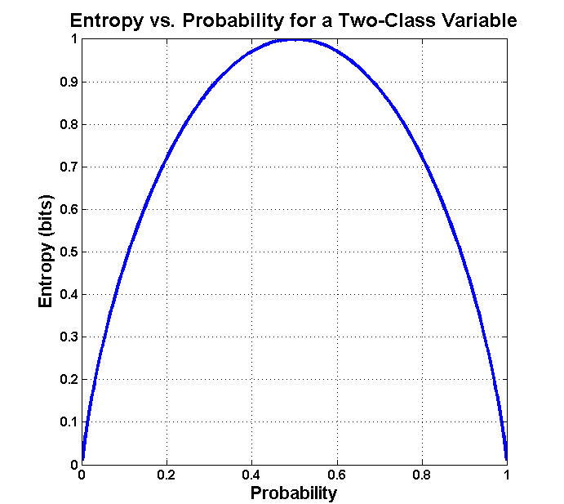
Question – What is the distribution of entropy for a fair coin

Slide 16
Compute information gain
Information gain: information before splitting – information after splitting
Information gain for attributes from weather data:

Slide 17
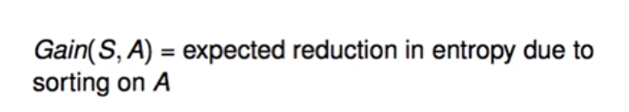
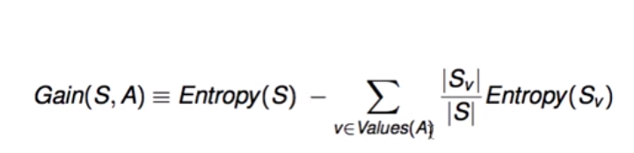

So information gain can be represented as

Slide 18
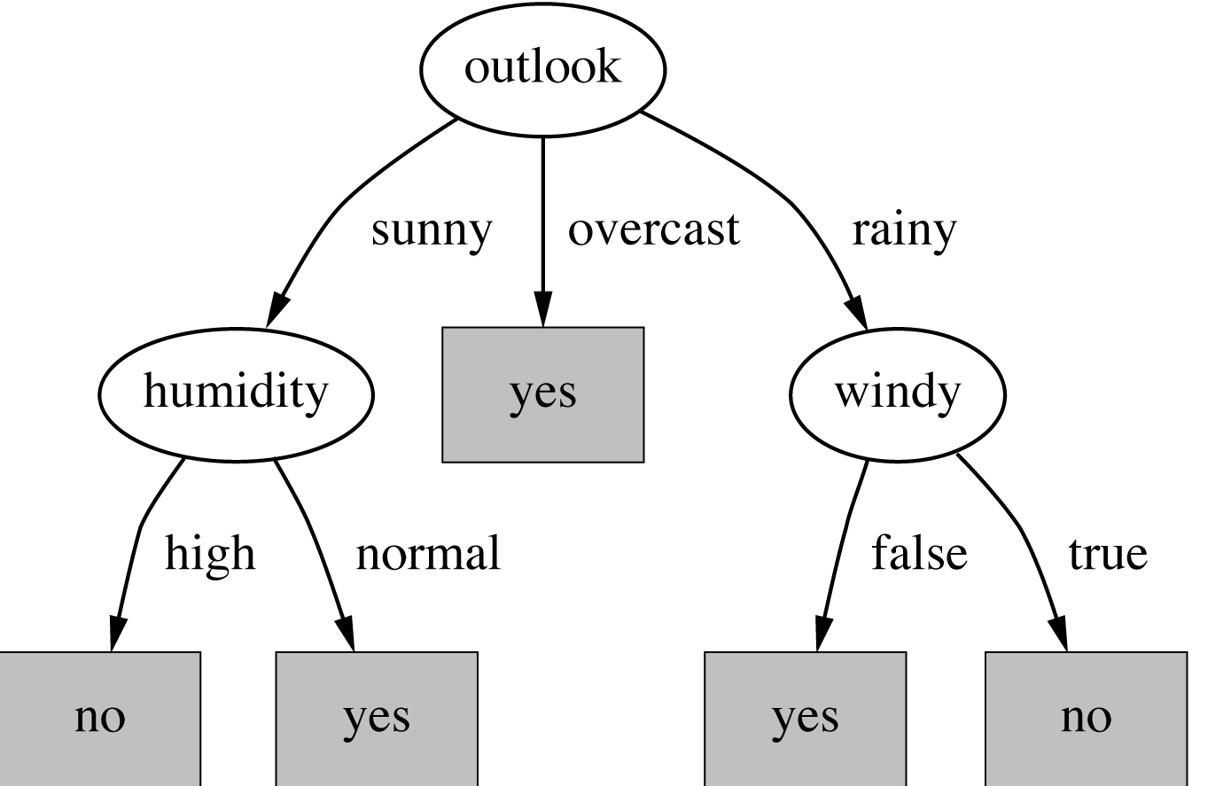
Final Decision tree

Slide 19
Alright, what is the downside of this algo?
Attributes with a large number of values (extreme case: User ID, Partition Keys)
Subsets are more likely to be pure if there is a large number of values
Information gain is biased towards choosing attributes with a large number of values
This may result in overfitting (selection of an attribute that is non-optimal for prediction)
Another problem: fragmentation

Slide 20
Gain Ratio
Gain ratio: a modification of the information gain that reduces its bias on high-branch attributes
Gain ratio takes number and size of branches into account when choosing an attribute
It corrects the information gain by taking the intrinsic information of a split into account
Also called split ratio

Slide 21
Gain Ratio
Gain ratio: a modification of the information gain that reduces its bias on high-branch attributes
Gain ratio takes number and size of branches into account when choosing an attribute
It corrects the information gain by taking the intrinsic information of a split into account
Also called split ratio

Slide 22
Gain Ratio
Gain ratio should be
Large when data is evenly spread
Small when all data belong to one branch
Gain ratio (Quinlan’86) normalizes info gain by this reduction.

Slide 23
Gain ratio - Importance of attribute decreases as intrinsic information gets larger
Imagine each of them to be individual days of a month then
Importance of attribute decreases as intrinsic information gets larger
Example of gain ratio:
Example:

Slide 24
Split by gain ratio
Outlook |  | Temperature
Info: | 0.693 | Info: | 0.911
Gain: 0.940-0.693 | 0.247 | Gain: 0.940-0.911 | 0.029
Split info: info([5,4,5]) | 1.577 | Split info: info([4,6,4]) | 1.362
Gain ratio: 0.247/1.577 | 0.156 | Gain ratio: 0.029/1.362 | 0.021
Humidity |  | Windy
Info: | 0.788 | Info: | 0.892
Gain: 0.940-0.788 | 0.152 | Gain: 0.940-0.892 | 0.048
Split info: info([7,7]) | 1.000 | Split info: info([8,6]) | 0.985
Gain ratio: 0.152/1 | 0.152 | Gain ratio: 0.048/0.985 | 0.049

Slide 25
Is Gain ratio the perfect one?
“Outlook” still comes out top
However: day of the month has greater gain ratio
Standard fix: ad hoc test to prevent splitting on that type of attribute
Problem with gain ratio: it may overcompensate
May choose an attribute just because its intrinsic information is very low
Standard fix:
First, only consider attributes with greater than average information gain
Then, compare them on gain ratio

Slide 26
If a data set T contains examples from n classes, gini index, gini(T) is defined as
where pj is the relative frequency of class j in T. gini(T) is minimized if the classes in T are skewed.
After splitting T into two subsets T1 and T2 with sizes N1 and N2, the gini index of the split data is defined as
The attribute providing smallest ginisplit(T) is chosen to split the node.

Slide 27
ID3 vs c4.5
Algorithm for top-down induction of decision trees (“ID3”) was developed by Ross Quinlan
Gain ratio just one modification of this basic algorithm
Led to development of C4.5, which can deal with numeric attributes, missing values, and noisy data

Slide 28
Kappa Statistic
The Kappa statistic (or value) is a metric that compares an Observed Accuracy with an Expected Accuracy (random chance).
It takes into account random chance (agreement with a random classifier) - an Observed Accuracy of 80% is a lot less impressive with an Expected Accuracy of 75% versus an Expected Accuracy of 50%

Slide 29
Kappa Statistic
 | Cats | Dogs
Cats | 10 | 7
Dog | 5 | 8
In supervised machine learning, one "rater" reflects ground truth (the actual values of each instance to be classified), obtained from labeled data, and the other "rater" is the machine learning classifier used to perform the classification. Ultimately it doesn't matter which is which to compute the kappa statistic, but for clarity's sake lets say that the columns reflect ground truth and the rows reflect the machine learning classifier classifications

